Slide 1
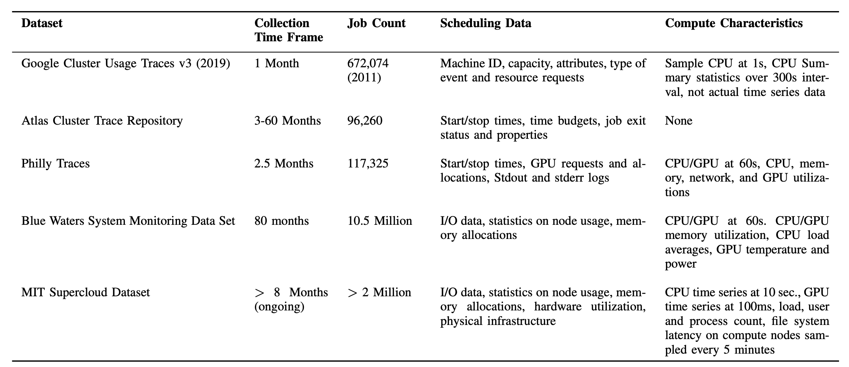
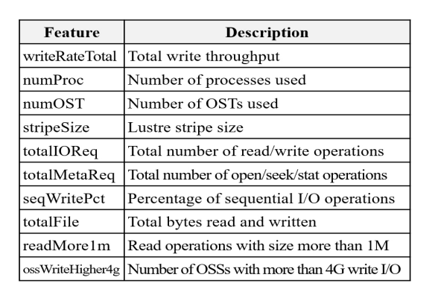
The MIT Supercloud Workload Classification Challenge
Workload classification helps to identify compute characteristics of unknown workloads and either present optimization pathways or alternatives to resource scheduling to minimize waste.
2. Other Data:
J. Wilkes, “More Google cluster data.” [Online]. Available: https: //ai.googleblog.com/2011/11/more-google-cluster-data.html
J. Wilkes and C. Reiss, “Clusterdata 2011 traces.” [Online]. Available: https://github.com/google/cluster-data/blob/master/ ClusterData2011 2.md
J. Wilkes, “Clusterdata 2019 traces.” [Online]. Available: https: //github.com/google/cluster-data/blob/master/ClusterData2019.md
G. Amvrosiadis, M. Kuchnik, J. W. Park et al., “The atlas cluster trace repository,” Usenix Mag., vol. 43, no. 4, 2018.
M. Jeon, S. Venkataraman, A. Phanishayee et al., “Analysis of large-scale multi-tenant GPU clusters for DNN training workloads,” CoRR, vol. abs/1901.05758, 2019. [Online]. Available: http://arxiv.org/ abs/1901.05758
NCSA, “Blue waters data sets.” [Online]. Available: {https://bluewaters. ncsa.illinois.edu/data-sets}
Background:
J. Bang, C. Kim, K. Wu et al., HPC Workload Characterization Using Feature Selection and Clustering. New York, NY, USA: Association for Computing Machinery, 2020, p. 33–40.
No data
Unsupervised learning
1). Feature selection Methods: Mutual Information Regression, F Regression, Decision Tree, Extra tree
2). Clustering algorithms: KMeans Clustering, Gaussian Mixture Model, Ward Linkage Clustering
Notes:
在计算出矩阵X后，Gavel使用一个基于轮询的调度机制为每个模型分配资源，在每一个round结束后，会根据X(m, j)/模型m在加速器j上已经分配的时间片计算优先级，根据优先级高低决定下一轮的资源分配：

Slide 2
数据集比较
数据源 | 数据集 | 数据集时间范围 | 数据集中的作业数量 | 数据特征 | 时间窗口长度 | 数据粒度 | 已知数据用途
Google Borg compute clusters | Google Cluster Usage Traces v3 (2019) https://research.google/resources/datasets/google-cluster-workload-traces-2019/ | 1个月 | 672074 | 任务时间窗口内的平均CPU利用率 任务时间窗口内的CPU最大值 任务时间窗口内的平均内存利用率 任务时间窗口内的内存最大值 | 300秒 | 1秒 | 工作负载模式概况分析 工作负载聚类 工作负载分类
 |  |  |  | 机器信息 事件信息
Microsoft's internal Philly clusters | Philly Traces https://github.com/msr-fiddle/philly-traces | 2.5个月 | 117325 | 机器的GPU利用率 机器的CPU利用率 机器的内存利用率 | 非固定，为每个作业，每次尝试的从开始到结束的时间段 | 60秒 | 深度学习工作负载的异构感知集群调度策略 深度学习训练时平衡异构 GPU 集群的效率和公平性 减轻 DNN 训练中的数据停顿
 |  |  |  | 工作的状态，运行的集群 每个工作的开始与结束时间
Petascale Computing Facility sponsored by the National Science Foundation | Blue Waters data https://bluewaters.ncsa.illinois.edu/data-sets | 80个月 | 10500000 | 节点输入输出 节点CPU利用率 节点CPU平均负载 节点内存利用率 节点GPU利用率 节点GPU温度 节点GPU能耗 | 非固定，为每个节点每次从开始运行到结束运行的时间段 | 60秒 | 节点工作负载预测 节点工作调度 能耗预测
MIT Datacenter | MIT Supercloud Dataset s3://mit-supercloud-dataset/datacenter-challenge/202201/ | 8个月（最近一次更新在2022年1月） | 2000000 | 工作CPU利用率 工作内存利用率 | 非固定，数据收集在作业的前置处理开始时启动，并在作业的后置处理中停止 | 10秒 | 工作负载分类
 |  |  |  | 工作GPU利用率 工作GPU内存占用率 |  | 100毫秒
 |  |  |  | 节点用户进程数量 节点平均负载 节点文件系统访问延迟 | 非固定，从节点启动到节点关闭 | 5分钟
Alibaba’s microservices in the production cluster | Alibaba Cluster trace microservices v2021 https://github.com/alibaba/clusterdata/tree/master/cluster-trace-microservices-v2021 | 12小时 | 90000（容器） | 节点CPU利用率 节点内存利用率 | 12小时持续记录所有节点上的数据 | 30秒 | 微服务之间依赖的研究 影响微服务运行性能的因素研究 大规模微服务部署的分析 微服务容器自动缩放器 微服务资源管理器
 |  |  |  | 微服务CPU利用率 微服务内存利用率 |  | 60秒
 |  |  |  | 微服务调用图

Slide 3
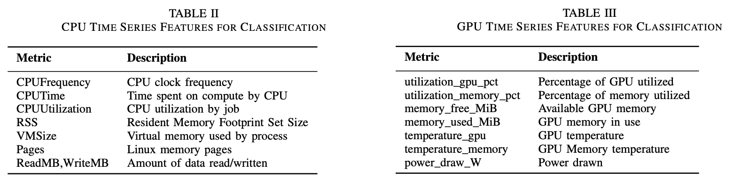
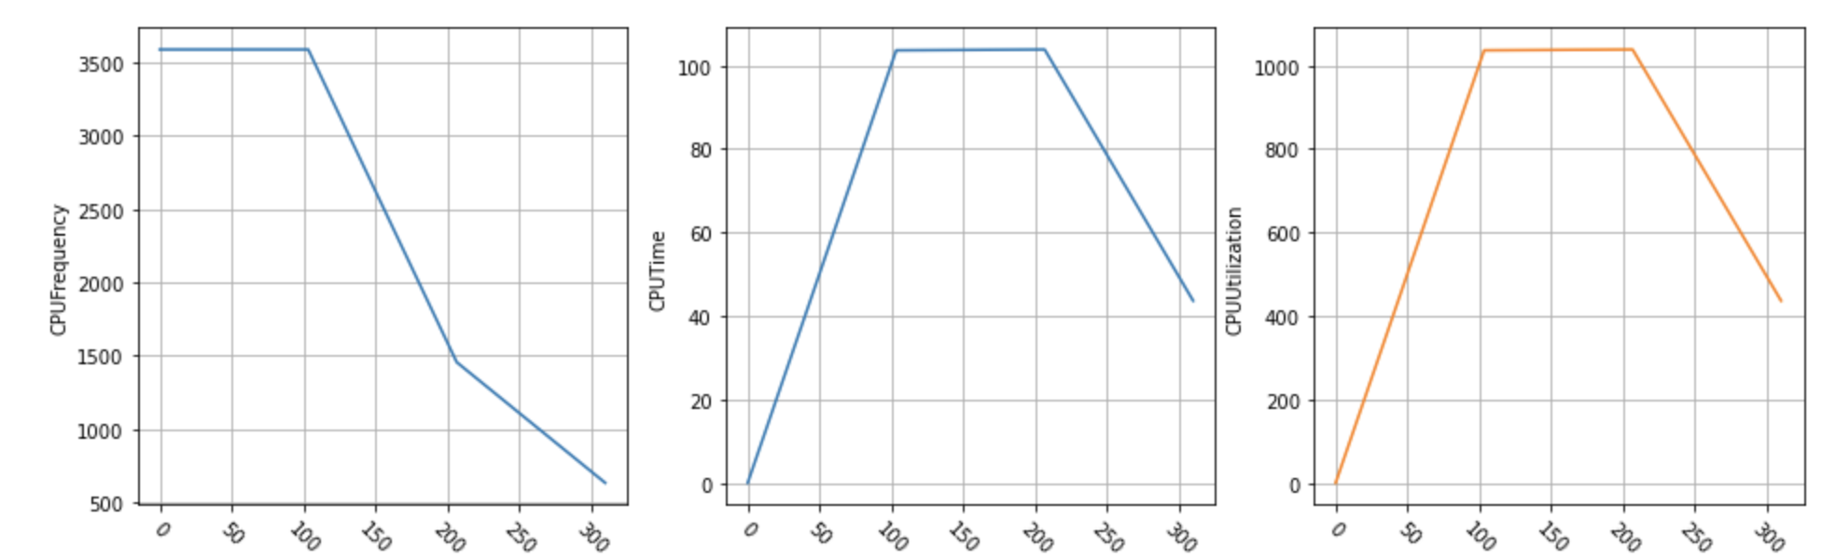
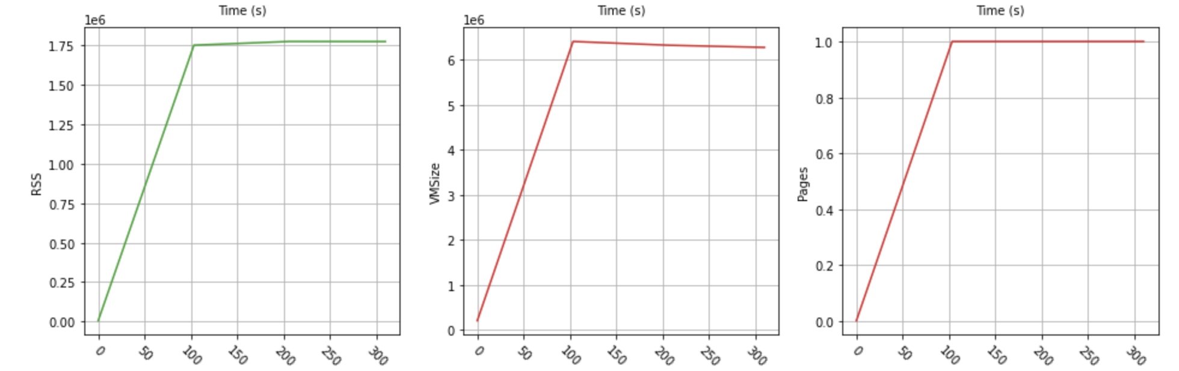
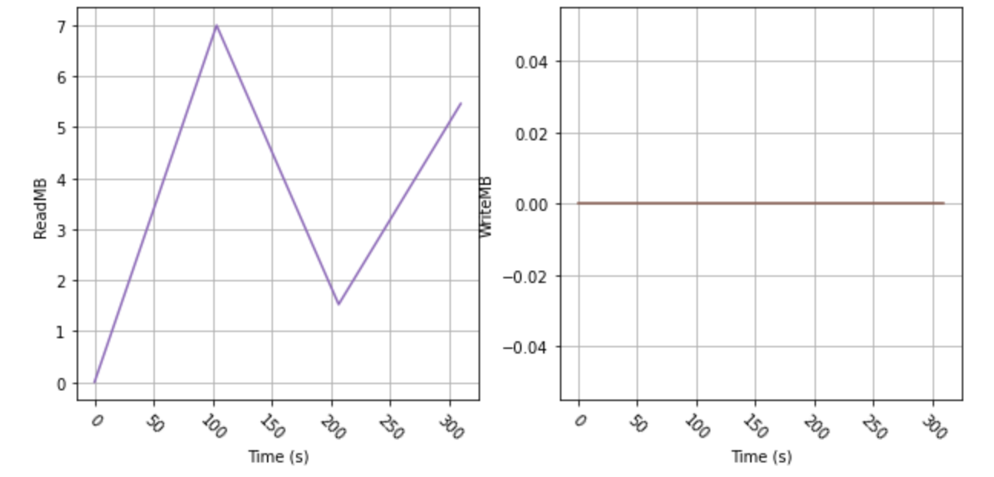
The MIT Supercloud Workload Classification Challenge
Workload classification helps to identify compute characteristics of unknown workloads and either present optimization pathways or alternatives to resource scheduling to minimize waste.
Data:
The MIT Supercloud Dataset consists of anonymized scheduler logs, time series data from CPUs and GPUs, monitoring data from each compute node. The uncompressed dataset is of the order of a Terabyte and is made available in compressed files. The dataset includes traces from 460,497 jobs, out of which 98,177 are jobs that requested GPUs for a variety of compute workloads which include AI/ML training and inference.
CPU:
The `cpu` folder contains time-series profiling data collected using the Slurm profiler plugin on each node assigned to a job included in this dataset. The data is organized in 100 subfolders. Each CSV file in the archive contains CPU usage, memory usage and file read/write data collected at 10 second intervals. Also included is a summary of the usage data for each job in the corresponding folder.
How to use the CPU data: https://nbviewer.org/github/MIT-AI-Accelerator/MIT-Supercloud-Dataset/blob/main/notebooks/Intro-to-MIT-Supercloud-Dataset.ipynb
Notes:
在计算出矩阵X后，Gavel使用一个基于轮询的调度机制为每个模型分配资源，在每一个round结束后，会根据X(m, j)/模型m在加速器j上已经分配的时间片计算优先级，根据优先级高低决定下一轮的资源分配：

Slide 4
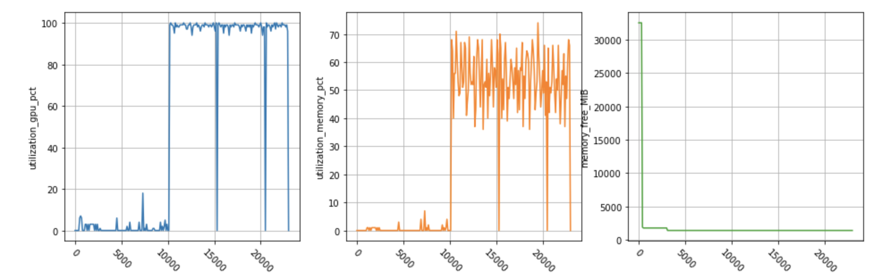
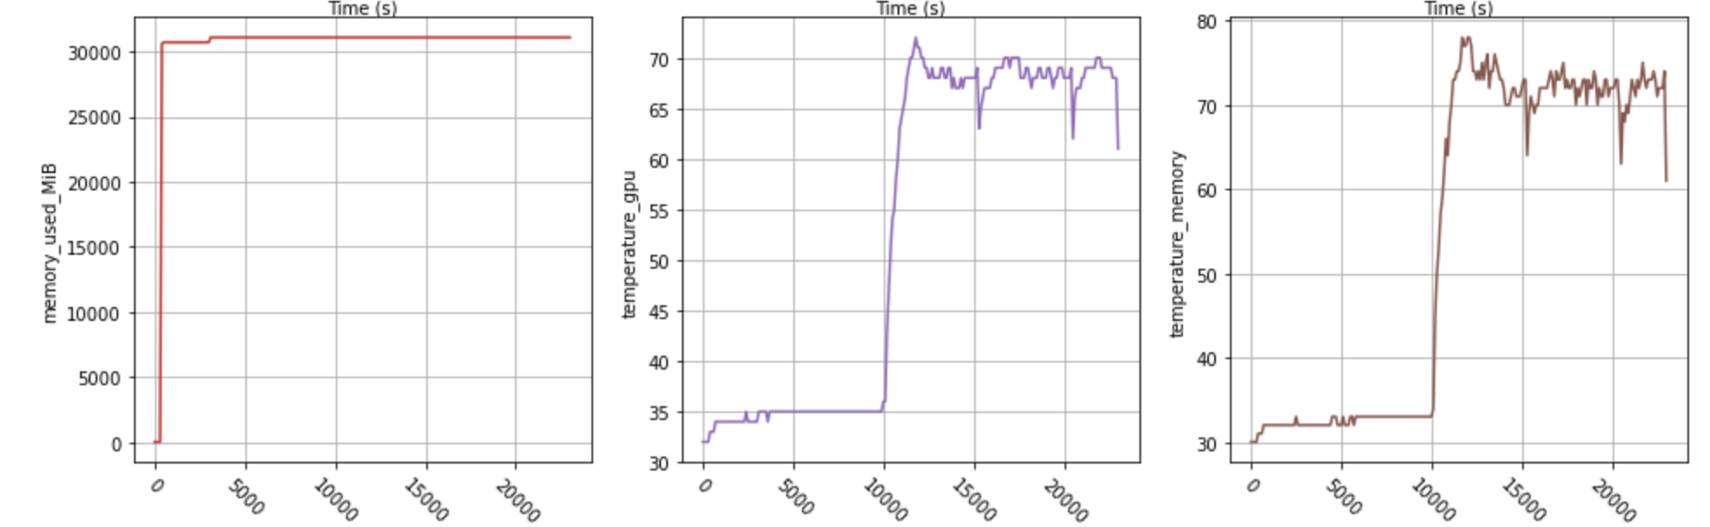
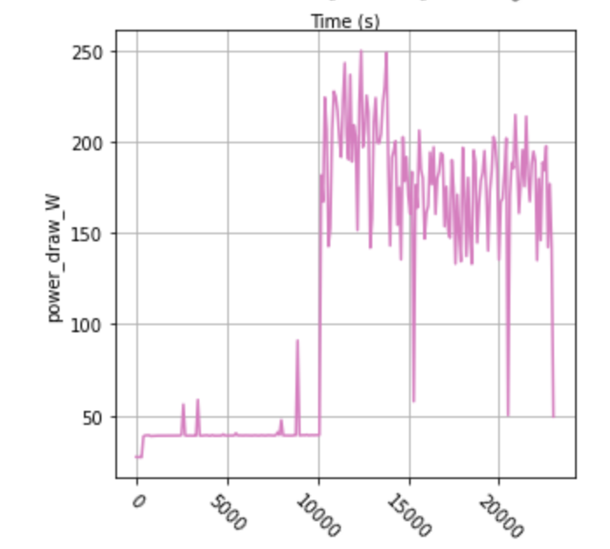
The MIT Supercloud Workload Classification Challenge
Workload classification helps to identify compute characteristics of unknown workloads and either present optimization pathways or alternatives to resource scheduling to minimize waste.
Data:
The MIT Supercloud Dataset consists of anonymized scheduler logs, time series data from CPUs and GPUs, monitoring data from each compute node. The uncompressed dataset is of the order of a Terabyte and is made available in compressed files. The dataset includes traces from 460,497 jobs, out of which 98,177 are jobs that requested GPUs for a variety of compute workloads which include AI/ML training and inference.
GPU:
The GPU utilization data is organized in 100 directories in the `gpu` folder. Each CSV file in these folders contains GPU usage data collected on all GPUs across all nodes assigned to a job. GPU data is collected using the `nvidia-smi` utility at 100 ms intervals.
How to use the GPU data: https://nbviewer.org/github/MIT-AI-Accelerator/MIT-Supercloud-Dataset/blob/main/notebooks/Intro-to-MIT-Supercloud-Dataset.ipynb
Notes:
在计算出矩阵X后，Gavel使用一个基于轮询的调度机制为每个模型分配资源，在每一个round结束后，会根据X(m, j)/模型m在加速器j上已经分配的时间片计算优先级，根据优先级高低决定下一轮的资源分配：

Slide 5
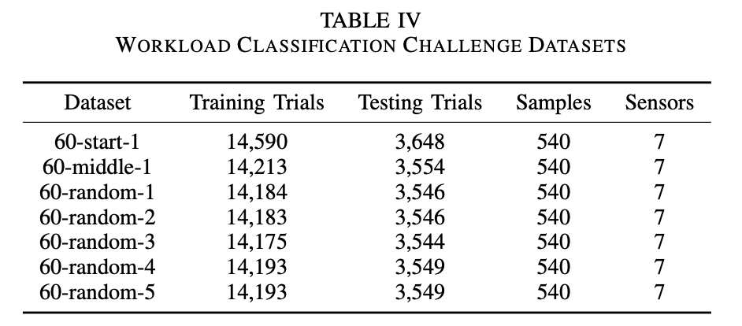
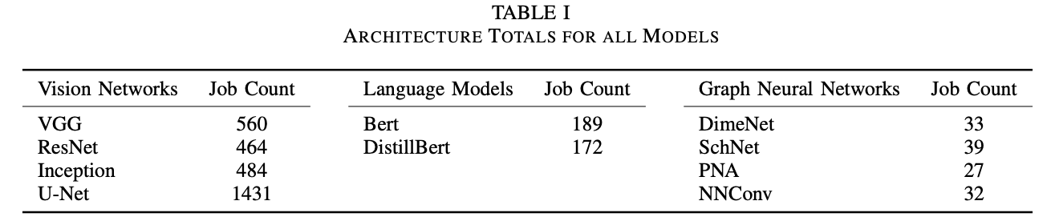
The MIT Supercloud Workload Classification Challenge
Detailed presentation of the MIT Supercloud Dataset’s labelled dataset:
The MIT Supercloud Dataset was collected on the TXGaia system, which is a heterogeneous cluster consisting of a set of GPU-accelerated nodes and another set of CPU-only nodes. The first partition has 224 nodes with two 20-core Intel Xeon Gold 6248 processors with a total 384GB of RAM and two NVIDIA Volta V100 GPUs with 32GB of RAM each.
The dataset consists of time series of CPU and GPU utilization, memory utilization, GPU temperature, snapshots of compute node state, file I/O, as well as the scheduler log.
At present, among the over 2 TB of data in the MIT Superclould Dataset, approximately 2 GB consist of labelled workloads, with 3,430 unique jobs. Found in labelled_jobids.csv.
The labelled data was created by running and manually labelling commonly used deep neural networks in vision, Natural Language Processing (NLP) and Graph Neural Networks (GNN). At present, there are ten deep neural network models in the labelled dataset as shown in Table I.
All data in the labelled dataset includes both CPU and GPU time series. Due to the fact a single job may request multiple GPUs across multiple nodes, the number of distinct GPU time series is larger than 3,430.
The features in the CPU and GPU datasets relevant to classification:
https://github.com/MIT-AI-Accelerator/MIT-Supercloud-Dataset/tree/main
The datasets were generated by sampling in three different ways: the first 60 seconds of each time series, the middle 60 seconds of each time series, and a 60 second sample drawn at random from the time series.
Each dataset is saved in the Numpy npz format and contains following the files: X_train, y_train, model_train, X_test, y_test, model_test.
Using the training sets as an example, X_train is a three dimensional vector containing the time series data. For example, in the 60-start-1 dataset, the dimensions are (14590, 540, 7) which correspond to trials, time series samples, and sensors respectively. Y_train is a vector of integer class labels. model_train contains the text names of the models corresponding to each numerical label in y_train.
Introduction:
Performance Heterogeneity: Commonly used models show heterogeneous performance behavior across accelerator types due to various architectural differences. Existing schedulers like Gandiva, Tiresias, and Themis do not consider this heterogeneous performance behavior.
Generality across Policies: Cluster operators might want to implement different scheduling policies based on their business goals, such as optimizing for time to complete a set of batch jobs (makespan), fairness for ad-hoc jobs, or more sophisticated hierarchical policies that divide resources among high-level entities (e.g., departments) using one policy, and then individual jobs within the entity using another
Colocation and Placement Optimizations:

Slide 6
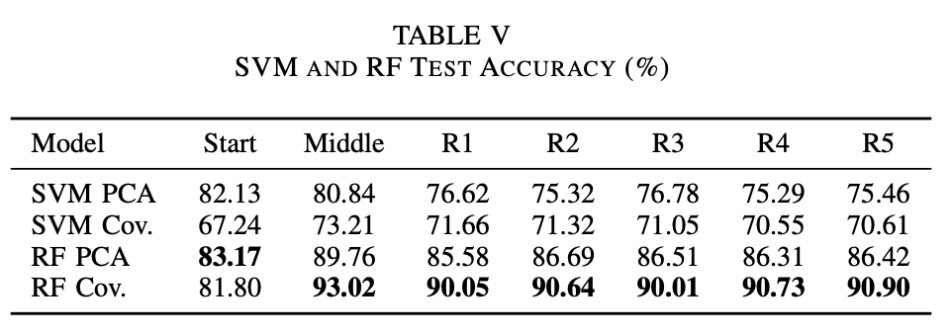
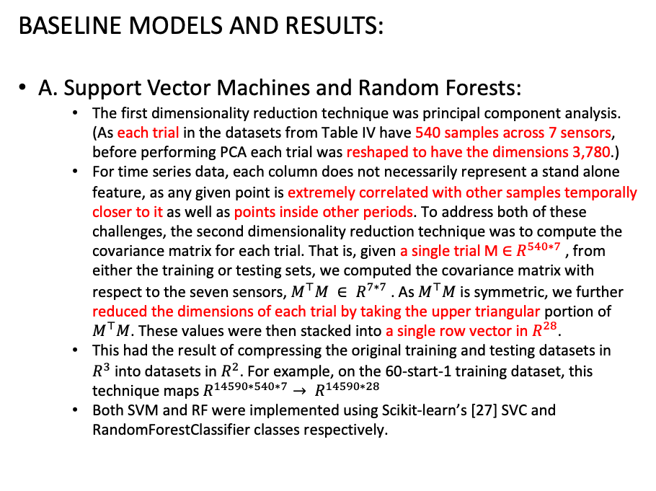
The MIT Supercloud Workload Classification Challenge
BASELINE MODELS AND RESULTS:
A. Support Vector Machines and Random Forests:
The first dimensionality reduction technique was principal component analysis. (As each trial in the datasets from Table IV have 540 samples across 7 sensors, before performing PCA each trial was reshaped to have the dimensions 3,780.)
For time series data, each column does not necessarily represent a stand alone feature, as any given point is extremely correlated with other samples temporally closer to it as well as points inside other periods. To address both of these challenges, the second dimensionality reduction technique was to compute the covariance matrix for each trial. That is, given a single trial M ∈ $R^{540∗7}$, from either the training or testing sets, we computed the covariance matrix with respect to the seven sensors, $M^{⊤}M ∈ R^{7∗7}$. As $M^{⊤}M$ is symmetric, we further reduced the dimensions of each trial by taking the upper triangular portion of $M^{⊤}M$. These values were then stacked into a single row vector in $R^{28}$.
This had the result of compressing the original training and testing datasets in $R^{3}$into datasets in $R^{2}$. For example, on the 60-start-1 training dataset, this technique maps $R^{14590∗540∗7}→ R^{14590∗28}$
Both SVM and RF were implemented using Scikit-learn’s [27] SVC and RandomForestClassifier classes respectively.
B. Regularizing Gradient-Boosting Classifier:
We evaluated its performance on the 60- random-1 dataset, applying standardization and covariance dimensionality reduction as in Section IV-A.
Our XGBoost model achieved a test set accuracy of 88.47% after 40 boosting rounds.
C. LSTM:
Prior to training, each dataset was standardized using Scikit Learn’s StandardScaler class as in Section IV. No other feature engineering or preprocessing was applied to the datasets.
We picked a fairly straightforward standard bidirectional LSTM architecture. A bidirectional LSTM trains two LSTMs on the input sequence, one from start-to-end, and the other in reverse.
The input sequence is fed into a bidirectional LSTM with a hidden layer size of 128 with all 7 sensors as the feature vector.
Then, the output of both LSTMs were concatenated and passed through a fully-connected layer projecting down to a feature size equal to the length of the sequence.
This was then passed through a dropout layer with p=0.5 to reduce overfitting, a leaky rectified linear unit (leaky ReLU) activation function as a non-linearity, and finally fed into another fully-connected layer that outputs a vector of size equal to the number of classes we are predicting.
Lastly, we apply a log-softmax transform on the output vector to get the log-probabilities of our classes.
Introduction:
Performance Heterogeneity: Commonly used models show heterogeneous performance behavior across accelerator types due to various architectural differences. Existing schedulers like Gandiva, Tiresias, and Themis do not consider this heterogeneous performance behavior.
Generality across Policies: Cluster operators might want to implement different scheduling policies based on their business goals, such as optimizing for time to complete a set of batch jobs (makespan), fairness for ad-hoc jobs, or more sophisticated hierarchical policies that divide resources among high-level entities (e.g., departments) using one policy, and then individual jobs within the entity using another
Colocation and Placement Optimizations:

Slide 7
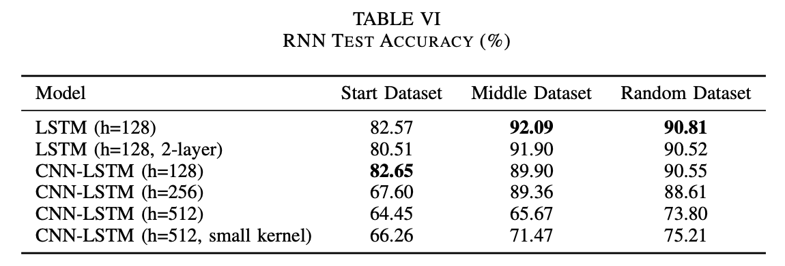
The MIT Supercloud Workload Classification Challenge
BASELINE MODELS AND RESULTS:
D. Applying Convolutions to LSTMs:
Prior to training, each dataset was standardized using Scikit Learn’s StandardScaler class as in Section IV. No other feature engineering or preprocessing was applied to the datasets.
We feed the input sequence into two 1-dimensional convolutional layers sandwiching a max pooling layer to reduce the dimensionality of the feature maps.
This output is then fed into the same bidirectional LSTM architecture from Section V-A and trained in the same manner.
Because the training time of RNNs increases with the length of the input sequence, this had the side benefit of speeding up training time by almost 8 times
Code for models:
The known workloads above used open source implementations and publicly available datasets as listed below:
- TensorFlow implementations of VGG, ResNet and Inception are available from https://github.com/tensorflow/benchmarks/tree/master/scripts/tf_cnn_benchmarks
These models were trained on the ImageNet dataset.
- U-Net models used here are described in the paper [_SEVIR : A Storm Event Imagery Dataset for Deep Learning Applications in Radar and Satellite Meteorology_](https://proceedings.neurips.cc/paper/2020/hash/fa78a16157fed00d7a80515818432169-Abstract.html), NeurIPS 2020. Implementations and dataset used for training are available from https://github.com/MIT-AI-Accelerator/neurips-2020-sevir.
- Pytorch implementations of Bert and DistillBert from the HuggingFace library were trained on fine tuning tasks. Available at https://huggingface.co.
- Pytorch implementations of DimeNet, SchNet, NNConv, and PNA are available in the `pytorch-geometric` package. For documentation see the following pages:
- https://pytorch-geometric.readthedocs.io/en/latest/_modules/torch_geometric/nn/models/dimenet.html
- https://pytorch-geometric.readthedocs.io/en/latest/_modules/torch_geometric/nn/models/schnet.html
- https://pytorch-geometric.readthedocs.io/en/latest/modules/nn.html#torch_geometric.nn.conv.NNConv
- https://pytorch-geometric.readthedocs.io/en/latest/_modules/torch_geometric/nn/conv/pna_conv.html
Introduction:
Performance Heterogeneity: Commonly used models show heterogeneous performance behavior across accelerator types due to various architectural differences. Existing schedulers like Gandiva, Tiresias, and Themis do not consider this heterogeneous performance behavior.
Generality across Policies: Cluster operators might want to implement different scheduling policies based on their business goals, such as optimizing for time to complete a set of batch jobs (makespan), fairness for ad-hoc jobs, or more sophisticated hierarchical policies that divide resources among high-level entities (e.g., departments) using one policy, and then individual jobs within the entity using another
Colocation and Placement Optimizations:

Slide 8
High dimensional data + dimensional reduction vs lower dimensional data
Thoughts:
High dimensional data >= Low dimensional data.
1. We can always do feature selection to search for the subset of features that are relevant. There is a comparative study of 6 different feature selection thecniques:
https://www.researchgate.net/publication/306304009_Comparative_Study_of_Feature_Subset_Selection_Methods_for_Dimensionality_Reduction_on_Scientific_Data
https://www.researchgate.net/publication/360811068_Feature_Selection_A_Review_and_Comparative_Study
2. Dimensionality reduction methods can effectively address multicollinearity, which occurs when features in a dataset are highly correlated with each other. High multicollinearity can lead to unstable and unreliable models. By transforming the features into a lower-dimensional space, dimensional reduction techniques can help mitigate the issue of multicollinearity and improve the stability and interpretability of models.
e.g. Suppose the model is fitted with two variables: Square footage (X1) and Number of rooms (X2)
Introduction:
Performance Heterogeneity: Commonly used models show heterogeneous performance behavior across accelerator types due to various architectural differences. Existing schedulers like Gandiva, Tiresias, and Themis do not consider this heterogeneous performance behavior.
Generality across Policies: Cluster operators might want to implement different scheduling policies based on their business goals, such as optimizing for time to complete a set of batch jobs (makespan), fairness for ad-hoc jobs, or more sophisticated hierarchical policies that divide resources among high-level entities (e.g., departments) using one policy, and then individual jobs within the entity using another
Colocation and Placement Optimizations:

Slide 9
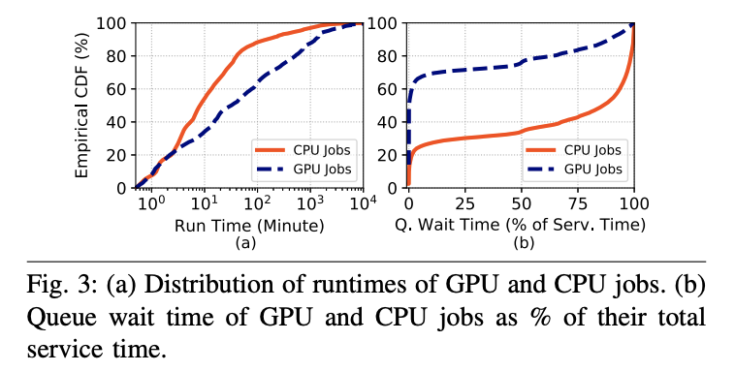
AI-Enabling Workloads on Large-Scale GPU-Accelerated System:
Characterization, Opportunities, and Implications
SYSTEM SPECIFICATIONS AND OPERATIONAL LESSONS:
CHARACTERIZATION OF GENERAL JOB BEHAVIOR AND RESOURCE UTILIZATION:
System Description: The Supercloud system is an HPC cluster designed for GPU-accelerated AI workloads, including the needs of the Air Force and government labs. It consists of 224 Intel Xeon Gold 6248 based nodes (two CPUs per node, each with 20 cores; 2-way hyperthreading per-core), each with two Nvidia Volta V100 GPUs. There are 448 GPUs in total, each with a RAM of 32GB. The node configuration is shown in Fig. 1. Each node has a RAM of 384 GB, with a local storage capacity of 1TB SSD + 3.8 TB HDD and a total distributed solid-state storage capacity of 843 TB.
Types of Workloads and Users: Several different types of workloads run on the Supercloud system: deep learning, batch jobs, interactive jobs, map-reduce, data visualization and analysis, and general machine learning and artificial intelligence workloads.
System Monitoring: The Supercloud system uses Slurm workload manager for job scheduling. Data collection for this study leveraged Slurm’s built-in capabilities to enable transparent, lightweight, and automated system monitoring. The Nvidia System Management Interface (nvidia-smi) is a command-line utility that enables the management and monitoring of Nvidia GPU devices
The most basics of these characteristics are the service time characteristics such as the run times and the queue wait times of the GPU-accelerated jobs (GPU jobs).
Fig. 3(a) shows the empirical cumulative distribution function (CDF) of the queue wait times and run times of all GPU jobs. First, we look at the characteristics of the GPU jobs. While the median run time of GPU jobs is 30 minutes, GPU jobs have a diverse set of run times: the 25th percentile run time is 4 minutes and the 75th percentile is 300 minutes (note that the x-axis of run times has a logarithmic scale). In fact, the run time for some jobs can be as low as less than 1 minute, and for others, it can be as high as more than 20 hours.
Next, we look at the runtimes of CPU jobs (jobs without GPU request) for comparison. The figure shows that CPU jobs run for a much shorter duration than GPU jobs. While CPU jobs tend to have shorter run times, they tend to have relatively longer queue wait times than GPU jobs.
Introduction:
Performance Heterogeneity: Commonly used models show heterogeneous performance behavior across accelerator types due to various architectural differences. Existing schedulers like Gandiva, Tiresias, and Themis do not consider this heterogeneous performance behavior.
Generality across Policies: Cluster operators might want to implement different scheduling policies based on their business goals, such as optimizing for time to complete a set of batch jobs (makespan), fairness for ad-hoc jobs, or more sophisticated hierarchical policies that divide resources among high-level entities (e.g., departments) using one policy, and then individual jobs within the entity using another
Colocation and Placement Optimizations:

Slide 10
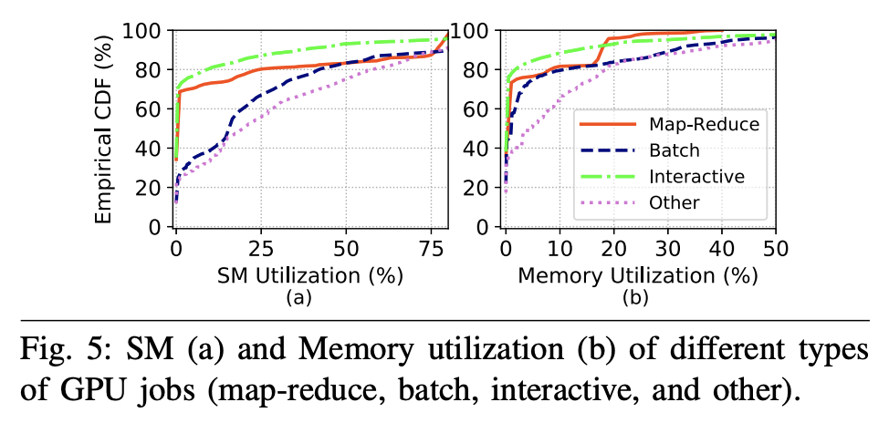
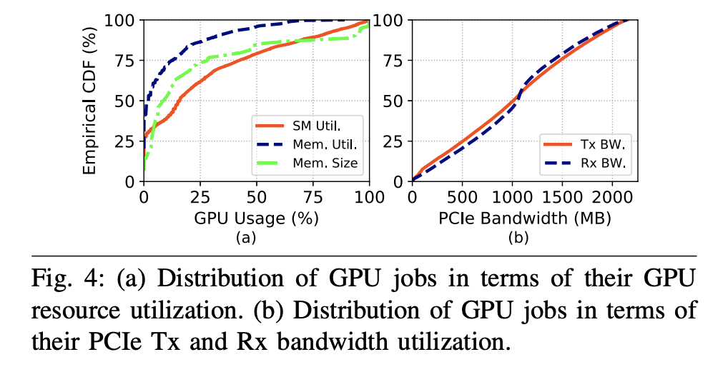
AI-Enabling Workloads on Large-Scale GPU-Accelerated System:
Characterization, Opportunities, and Implications
CHARACTERIZATION OF GENERAL JOB BEHAVIOR AND RESOURCE UTILIZATION:
Fig. 4(a) shows the empirical CDFs of the average utilization of different GPU resources including SM (usage percentage of the GPU streaming multiprocessors), memory (percentage of the GPU memory bandwidth used), and memory size (percentage of the GPU memory amount used). In general, we observe that SM (median utilization is 16%) is more heavily utilized than memory bandwidth (median utilization is 2%) and size (median usage is 9%). This indicates that GPU workloads tend to be more compute-intensive, which is as expected as they are mostly deep learning and machine learning jobs.
Fig. 4(b) shows that different jobs achieve a wide range of PCIe bandwidths for both the transmission of packets (Tx bandwidth) and the receiving of packets (Rx bandwidth). The linearly increasing empirical CDF trend suggests a uniform distribution of bandwidths across all jobs.
While the average resource utilization of a GPU job is low, it is not representative of the utilization behavior at all times during the job’s run. Resource utilization can vary greatly during job execution, switching between idle and active phases, even reaching the maximum capacity at times.
But, the co-location opportunity is present due to explicit time-spaced idle phases on GPUs. Thus, there is a need and opportunity for developing production-suitable GPU job co-location tools that take into account temporal variation and bottlenecks, such that the performances of co-located jobs are not impacted.
From Fig. 4, we observe that most jobs do not fully utilize GPU resources: only 20% of the jobs have more than 50% SM utilization, only 4% of the jobs have more than 50% memory utilization, and only 15% of the jobs have more than 50% memory size usage. This demonstrates the opportunity for space-sharing of GPU resources among multiple jobs.
Introduction:
Performance Heterogeneity: Commonly used models show heterogeneous performance behavior across accelerator types due to various architectural differences. Existing schedulers like Gandiva, Tiresias, and Themis do not consider this heterogeneous performance behavior.
Generality across Policies: Cluster operators might want to implement different scheduling policies based on their business goals, such as optimizing for time to complete a set of batch jobs (makespan), fairness for ad-hoc jobs, or more sophisticated hierarchical policies that divide resources among high-level entities (e.g., departments) using one policy, and then individual jobs within the entity using another
Colocation and Placement Optimizations:

Slide 11
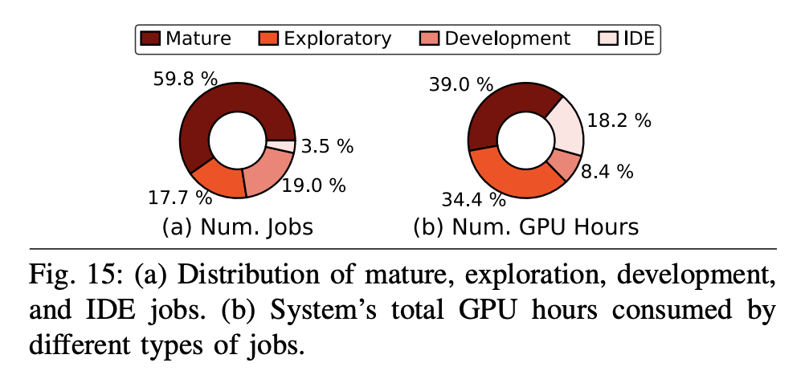
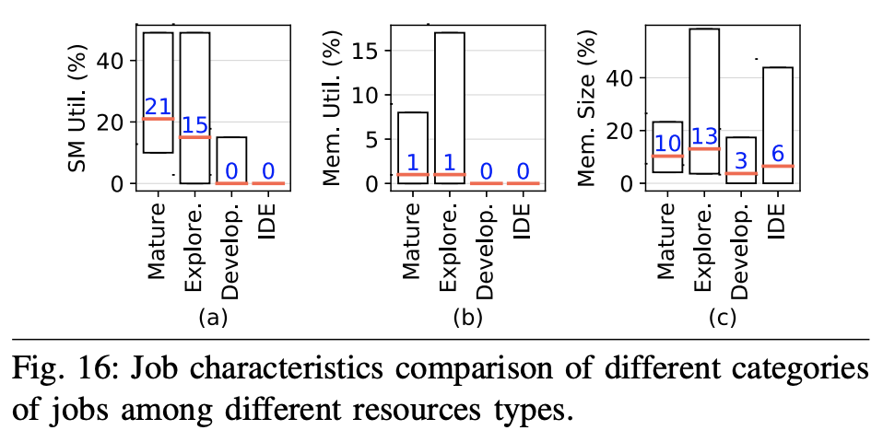
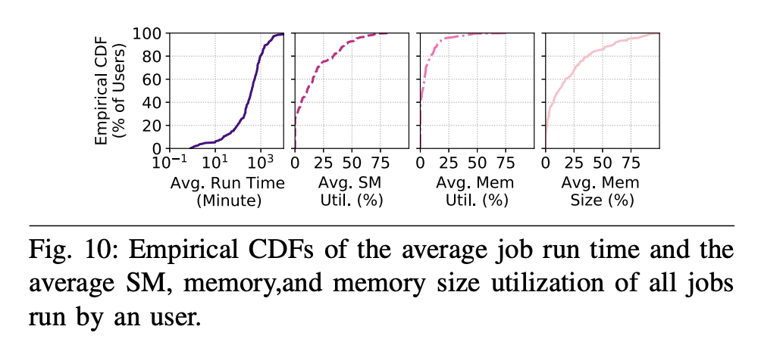
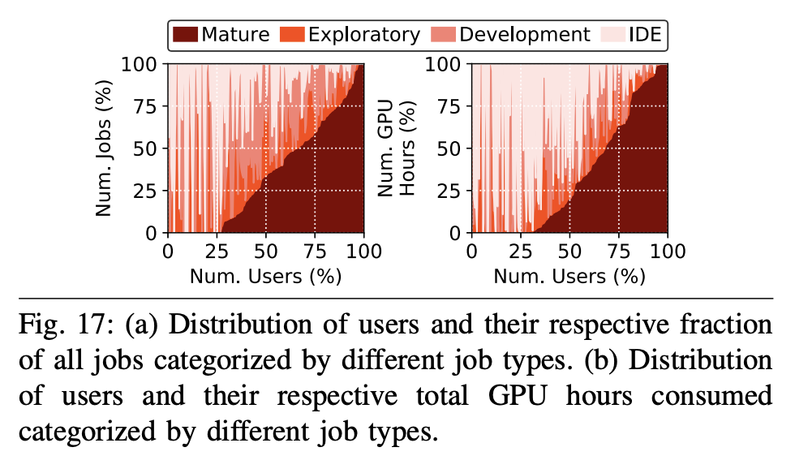
AI-Enabling Workloads on Large-Scale GPU-Accelerated System:
Characterization, Opportunities, and Implications
ANALYSIS OF USER BEHAVIOR AND TREND CHARACTERISTICS:
INVESTIGATION OF THE ALGORITHM DEVELOPMENT LIFE-CYCLE:
Over the duration of our study, 191 unique users executed 47,120 jobs in total on the Supercloud system. All users who executed GPU-accelerated jobs do not display the same average characteristics. To demonstrate this, in Fig. 10, we plot the empirical CDFs (across all users) of the average job run time and the average SM, memory, and memory size utilization of all jobs run by a user.
Our Supercloud users have a variety of average job run times and GPU resource utilization characteristics. Different users have different requirements and expectations from the system based on the types of jobs that they run. The system can be best served by identifying those needs and providing easyto-use solutions to improve efficiency and throughput. In our operational experience, we implemented one such solution by providing different interfaces for different job types for scheduling.
As the GPU-accelerated Supercloud system is geared toward deep learning jobs, a large portion of the jobs are exploratory as they are in the process of hyperparameter tuning.
Compared to mature and exploratory jobs on Supercloud, development and IDE jobs do not efficiently consume the GPU resources that they run on.
A large fraction of the users leverage the Supercloud system for exploratory, development, and IDE workloads. This trend reflects a paradigm shift on HPC systems as they move toward catering GPU-accelerated artificial intelligence and machine learning workloads.
Introduction:
Performance Heterogeneity: Commonly used models show heterogeneous performance behavior across accelerator types due to various architectural differences. Existing schedulers like Gandiva, Tiresias, and Themis do not consider this heterogeneous performance behavior.
Generality across Policies: Cluster operators might want to implement different scheduling policies based on their business goals, such as optimizing for time to complete a set of batch jobs (makespan), fairness for ad-hoc jobs, or more sophisticated hierarchical policies that divide resources among high-level entities (e.g., departments) using one policy, and then individual jobs within the entity using another
Colocation and Placement Optimizations:

Slide 12
The MIT Supercloud Workload Classification Challenge
Plan of VM workload Classification:
Lessons learnt from other:
Classification Methods are not supervising. SVM, RF, XGBoost, LSTM, CNN+LSTM
RF Cov. Best performance, but hyperparamter tuning is very important.
Next Step:
If we have labelled data, we can do RF Cov. and other methods for classification. Tune the hyperparamters to achieve the best result
If we have unlabelled data, we can still try to do unsupervised learning methods to cluster them: KMeans Clustering, Gaussian Mixture Model, Ward Linkage Clustering
Introduction:
Performance Heterogeneity: Commonly used models show heterogeneous performance behavior across accelerator types due to various architectural differences. Existing schedulers like Gandiva, Tiresias, and Themis do not consider this heterogeneous performance behavior.
Generality across Policies: Cluster operators might want to implement different scheduling policies based on their business goals, such as optimizing for time to complete a set of batch jobs (makespan), fairness for ad-hoc jobs, or more sophisticated hierarchical policies that divide resources among high-level entities (e.g., departments) using one policy, and then individual jobs within the entity using another
Colocation and Placement Optimizations:

